Slide 1
Structure of human eye, Image formation & Brightness adaptation and discrimination

Slide 2
STRUCTURE OF HUMAN EYE

Slide 3
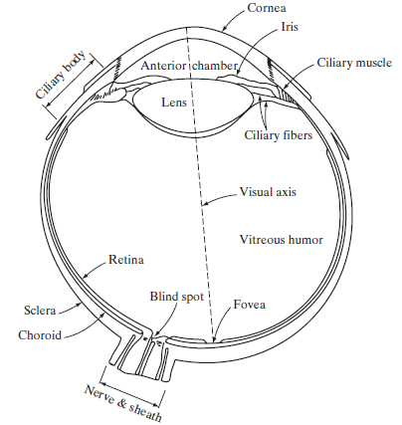
STRUCTURE OF HUMAN EYE
The eye is nearly a sphere, with an average diameter of approximately 20 mm.
Three membranes enclose the eye:
the cornea and sclera outer cover
the choroid and the retina.
The cornea is a tough, transparent tissue that covers the anterior surface of the eye.
Continuous with the cornea, the sclera is an opaque membrane that encloses the remainder of the optic globe.
Simplified diagram of a cross section of the human eye.
Notes:
Real world is continuous – an image is simply a digital approximation of this.

Slide 4
STRUCTURE OF HUMAN EYE (Contd.)
The choroid lies directly below the sclera. This membrane contains a network of blood vessels that serve as the major source of nutrition to the eye.
The choroid coat is heavily pigmented and hence helps to reduce the amount of extraneous light entering the eye and the backscatter within the optic globe.
At its anterior extreme, the choroid is divided into the ciliary body and the iris.
The latter contracts or expands to control the amount of light that enters the eye. The central opening of the iris (the pupil) varies in diameter from approximately 2 to 8 mm.
The front of the iris contains the visible pigment of the eye, whereas the back contains a black pigment.
Simplified diagram of a cross section of the human eye.
Notes:
Real world is continuous – an image is simply a digital approximation of this.

Slide 5
STRUCTURE OF HUMAN EYE (Contd.)
The lens is made up of concentric layers of fibrous cells and is suspended by fibers that attach to the ciliary body.
It contains 60 to 70% water, about 6% fat, and more protein than any other tissue in the eye. The lens is colored by a slightly yellow pigmentation that increases with age.
In extreme cases, excessive clouding of the lens, caused by the affliction commonly referred to as cataracts, can lead to poor color discrimination and loss of clear vision.
The lens absorbs approximately 8% of the visible light spectrum, with relatively higher absorption at shorter wavelengths.
Both infrared and ultraviolet light are absorbed appreciably by proteins within the lens structure and, in excessive amounts, can damage the eye.
Simplified diagram of a cross section of the human eye.
Notes:
Real world is continuous – an image is simply a digital approximation of this.

Slide 6
STRUCTURE OF HUMAN EYE (Contd.)
The innermost membrane of the eye is the retina, which lines the inside of the wall’s entire posterior portion.
When the eye is properly focused, light from an object outside the eye is imaged on the retina.
Pattern vision is afforded by the distribution of discrete light receptors over the surface of the retina.
There are two classes of receptors: cones and rods.
The cones in each eye number between 6 and 7 million. They are located primarily in the central portion of the retina, called the fovea, and are highly sensitive to color.
Muscles controlling the eye rotate the eyeball until the image of an object of interest falls on the fovea. Cone vision is called photopic or bright-light vision.
Simplified diagram of a cross section of the human eye.
Notes:
Real world is continuous – an image is simply a digital approximation of this.

Slide 7
STRUCTURE OF HUMAN EYE (Contd.)
The number of rods is much larger: Some 75 to 150 million are distributed over the retinal surface.
The larger area of distribution and the fact that several rods are connected to a single nerve end reduce the amount of detail discernible by these receptors.
Rods serve to give a general, overall picture of the field of view. They are not involved in color vision and are sensitive to low levels of illumination.
For example, objects that appear brightly colored in daylight when seen by moonlight appear as colorless forms because only the rods are stimulated.
This phenomenon is known as scotopic or dim-light vision.
The absence of receptors in this area results in the so-called blind spot
Simplified diagram of a cross section of the human eye.
Notes:
Real world is continuous – an image is simply a digital approximation of this.

Slide 8
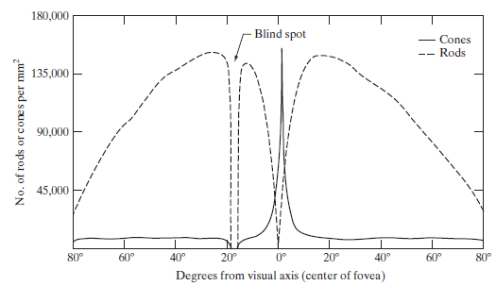
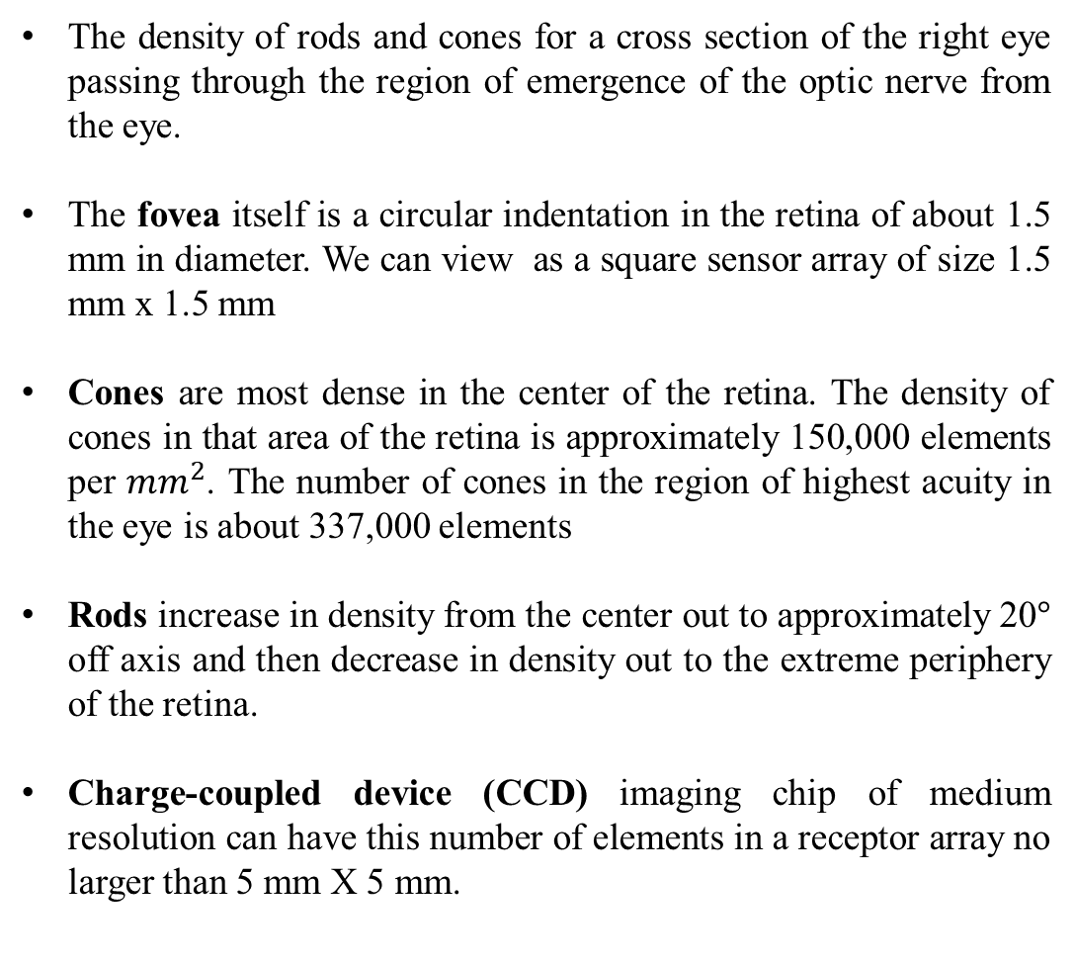
STRUCTURE OF HUMAN EYE (Contd.)
The density of rods and cones for a cross section of the right eye passing through the region of emergence of the optic nerve from the eye.
The fovea itself is a circular indentation in the retina of about 1.5 mm in diameter. We can view as a square sensor array of size 1.5 mm x 1.5 mm
Cones are most dense in the center of the retina. The density of cones in that area of the retina is approximately 150,000 elements per ${mm}^{2}$. The number of cones in the region of highest acuity in the eye is about 337,000 elements
Rods increase in density from the center out to approximately 20° off axis and then decrease in density out to the extreme periphery of the retina.
Charge-coupled device (CCD) imaging chip of medium resolution can have this number of elements in a receptor array no larger than 5 mm X 5 mm.
Distribution of rods and cones in the retina.
Notes:
Real world is continuous – an image is simply a digital approximation of this.

Slide 9
STRUCTURE OF HUMAN EYE - SUMMARY
Component | Description
Eye Diameter | Approximately 20 mm, nearly a sphere.
Membranes | Three membranes enclose the eye: cornea and sclera (outer cover), choroid and retina.
Cornea | Tough, transparent tissue covering the anterior surface of the eye.
Sclera | Opaque membrane enclosing the rest of the optic globe.
Choroid | Pigmented membrane below the sclera with blood vessels providing nutrition to the eye.
Iris | Part of the choroid; controls the amount of light entering the eye through the pupil.
Lens | Made of layers of fibrous cells, colored slightly yellow with age. Responsible for focusing light onto the retina.
Cataracts | Excessive clouding of the lens, leading to poor vision and color discrimination.
Retina | Innermost membrane containing light receptors (cones and rods) for pattern vision.
Cones | Approximately 6-7 million in each eye, concentrated in the fovea, highly sensitive to color (photopic vision).
Rods | Approximately 75-150 million, distributed over the retina, not involved in color vision, sensitive to low light (scotopic vision).
Blind Spot | Area where the optic nerve exits the eye, lacking receptors.
Fovea | Circular indentation in the retina, about 1.5 mm in diameter, with the highest density of cones (approximately 150,000 elements per mm²).
Cone Density | Approximately 150,000 elements per mm² in the central retina; 337,000 elements in the region of highest acuity.
Rod Density | Increases from the center to about 20° off-axis, then decreases towards the periphery.
CCD Imaging Chip | A medium-resolution chip can have the number of elements found in a receptor array no larger than 5 mm x 5 mm.
Notes:
Real world is continuous – an image is simply a digital approximation of this.

Slide 10
Image Formation in the Eye

Slide 11
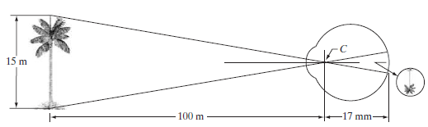
Image Formation in the Eye
In an ordinary photographic camera, the lens has a fixed focal length, and focusing at various distances is achieved by varying the distance between the lens and the imaging plane, where the film is located.
In the human eye, the converse is true; the distance between the lens and the imaging region (the retina) is fixed, and the focal length needed to achieve proper focus is obtained by varying the shape of the lens.
The distance between the center of the lens and the retina along the visual axis is approximately 17 mm. The range of focal lengths is approximately 14 mm to 17 mm, the latter taking place when the eye is relaxed and focused at distances greater than about 3 m.
Graphical representation of the eye looking at a palm tree. Point C is the optical center of the lens.

Slide 12
Image Formation in the Eye
The geometry in the below image illustrates how to obtain the dimensions of an image formed on the retina.
For example, suppose that a person is looking at a tree 15 m high at a distance of 100 m. Letting h denote the height of that object in the retinal image, the geometry of the below image yields 15/100 = h/17 or h=2.55 mm.
Perception then takes place by the relative excitation of light receptors, which transform radiant energy into electrical impulses that ultimately are decoded by the brain.
Graphical representation of the eye looking at a palm tree. Point C is the optical center of the lens.

Slide 13
Brightness adaptation and discrimination

Slide 14
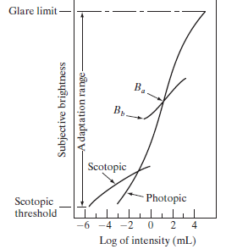
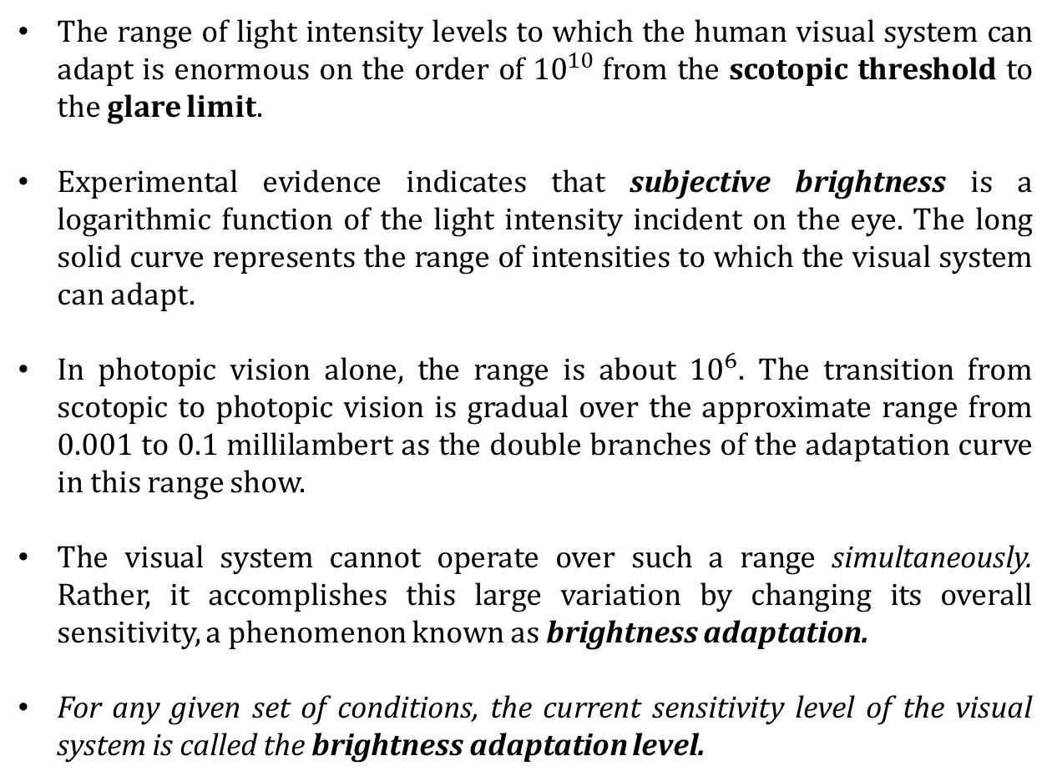
Brightness adaptation and discrimination
The range of light intensity levels to which the human visual system can adapt is enormous on the order of ${10}^{10}$from the scotopic threshold to the glare limit.
Experimental evidence indicates that subjective brightness is a logarithmic function of the light intensity incident on the eye. The long solid curve represents the range of intensities to which the visual system can adapt.
In photopic vision alone, the range is about ${10}^{6}$. The transition from scotopic to photopic vision is gradual over the approximate range from 0.001 to 0.1 millilambert as the double branches of the adaptation curve in this range show.
The visual system cannot operate over such a range simultaneously. Rather, it accomplishes this large variation by changing its overall sensitivity, a phenomenon known as brightness adaptation.
For any given set of conditions, the current sensitivity level of the visual system is called the brightness adaptation level.
Range of subjective brightness sensations showing a particular adaptation level

Slide 15
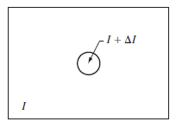
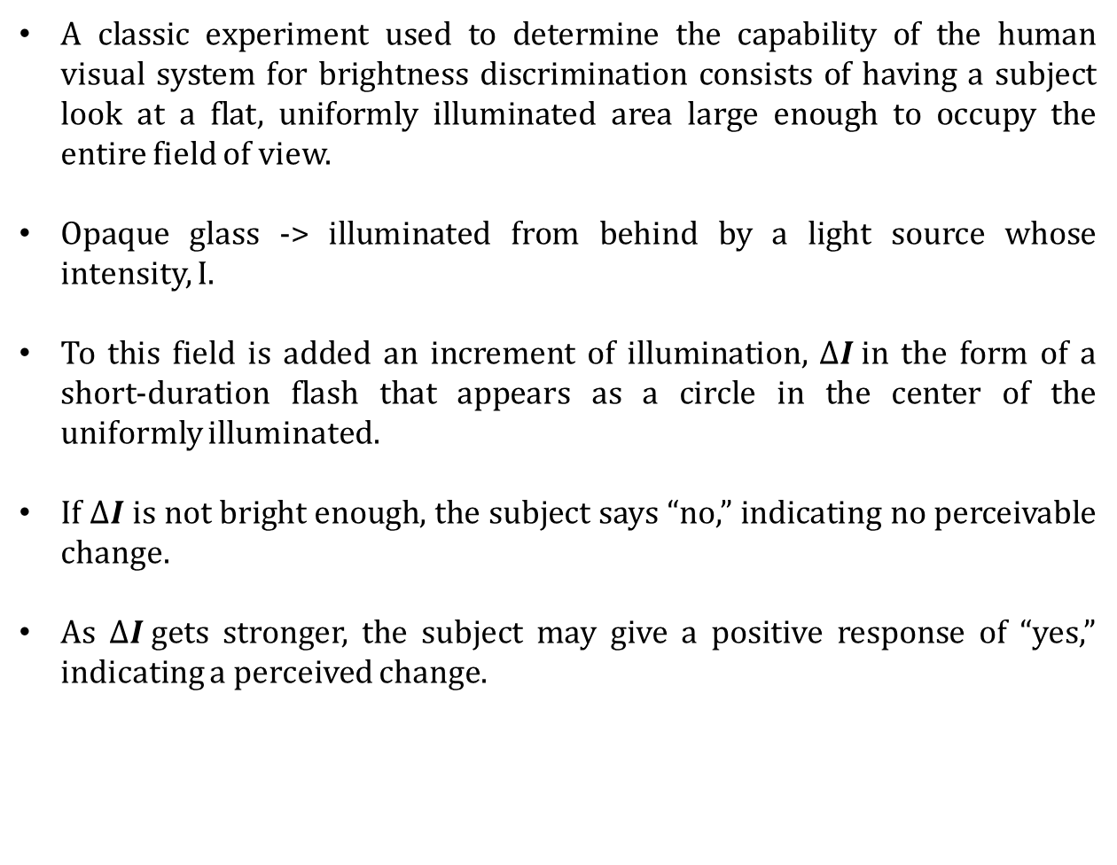
Basic experimental setup used to characterize brightness discrimination.
A classic experiment used to determine the capability of the human visual system for brightness discrimination consists of having a subject look at a flat, uniformly illuminated area large enough to occupy the entire field of view.
Opaque glass -> illuminated from behind by a light source whose intensity, I.
To this field is added an increment of illumination, $∆I$in the form of a short-duration flash that appears as a circle in the center of the uniformly illuminated.
If $∆I$ is not bright enough, the subject says “no,” indicating no perceivable change.
As $∆I$gets stronger, the subject may give a positive response of “yes,” indicating a perceived change.

Slide 16
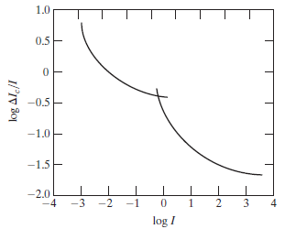
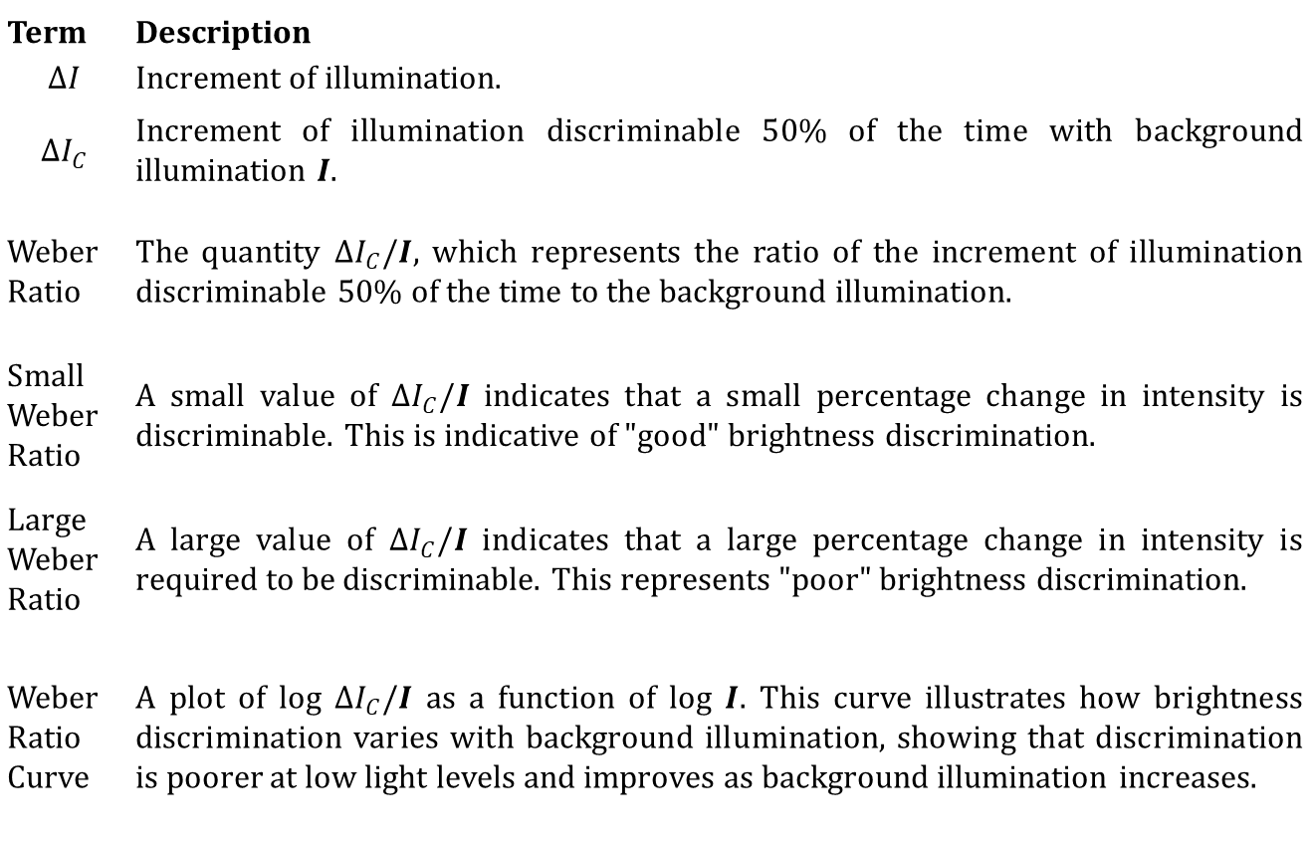
Basic experimental setup used to characterize brightness discrimination.
Term | Description
$$ΔI$$ | Increment of illumination.
$$ΔI_{C}$$ | Increment of illumination discriminable 50% of the time with background illumination 𝑰.
Weber Ratio | The quantity $ΔI_{C}$/𝑰, which represents the ratio of the increment of illumination discriminable 50% of the time to the background illumination.
Small Weber Ratio | A small value of $ΔI_{C}$/𝑰 indicates that a small percentage change in intensity is discriminable. This is indicative of "good" brightness discrimination.
Large Weber Ratio | A large value of $ΔI_{C}$/𝑰 indicates that a large percentage change in intensity is required to be discriminable. This represents "poor" brightness discrimination.
Weber Ratio Curve | A plot of log $ΔI_{C}$/𝑰 as a function of log 𝑰. This curve illustrates how brightness discrimination varies with background illumination, showing that discrimination is poorer at low light levels and improves as background illumination increases.
Typical Weber
ratio as a function
of intensity.

Slide 17
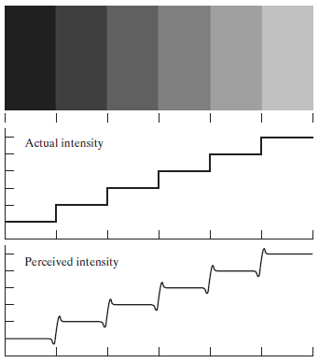
Mach Band Effect
The eye is capable of detecting objectionable contouring effects in monochrome images whose overall intensity is represented by fewer than approximately two dozen levels.
Two phenomena clearly demonstrate that perceived brightness is not a simple function of intensity.
The first is based on the fact that the visual system tends to undershoot or overshoot around the boundary of regions of different intensities.
The intensity of the stripes is constant, we actually perceive a brightness pattern that is strongly scalloped near the boundaries. These seemingly scalloped bands are called Mach bands.
The second phenomenon, called simultaneous contrast, is related to the fact that a region’s perceived brightness does not depend simply on its intensity
Illustration of the
Mach band effect.
Perceived
intensity is not a
simple function of
actual intensity.

Slide 18

Simultaneous Contrast
The second phenomenon, called simultaneous contrast, is related to the fact that a region’s perceived brightness does not depend simply on its intensity
All the center squares have exactly the same intensity.
However, they appear to the eye to become darker as the background gets lighter.
A more familiar example is a piece of paper that seems white when lying on a desk, but can appear totally black when used to shield the eyes while looking directly at a bright sky.
Examples of simultaneous contrast. All the inner squares have the same intensity, but they appear progressively darker as the background becomes lighter.

Slide 19
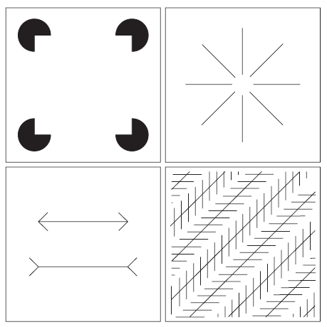
Optical Illusions
Outline of a square is seen clearly
The illusion of a complete circle
The two horizontal line segments are same
All lines are oriented at 45° are equidistant and parallel

Slide 20
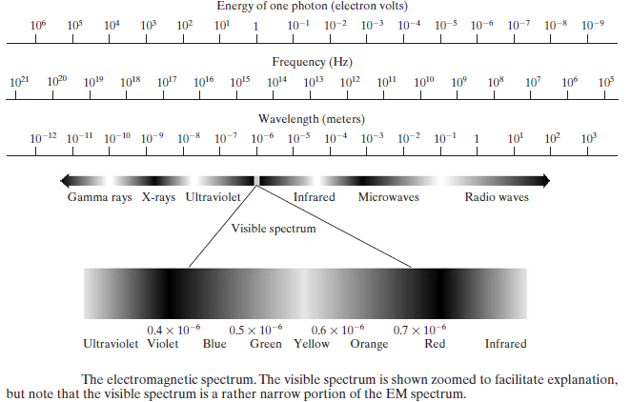
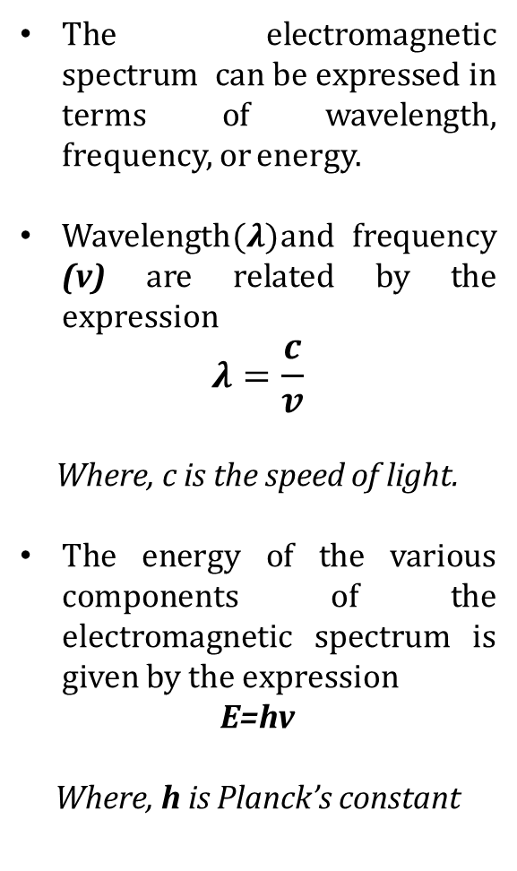
Light and the Electromagnetic Spectrum
The electromagnetic spectrum can be expressed in terms of wavelength, frequency, or energy.
Wavelength$(λ)$and frequency (v) are related by the expression
$$λ=\frac{c}{v}$$
Where, c is the speed of light.
The energy of the various components of the electromagnetic spectrum is given by the expression
E=hv
Where, h is Planck’s constant

Slide 21
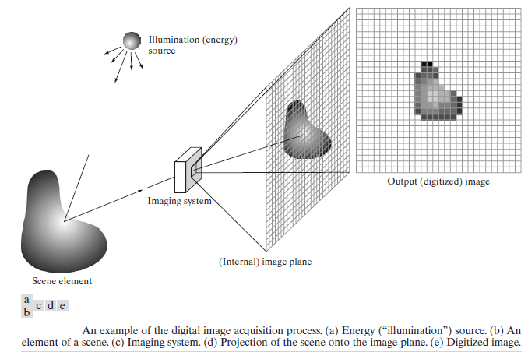
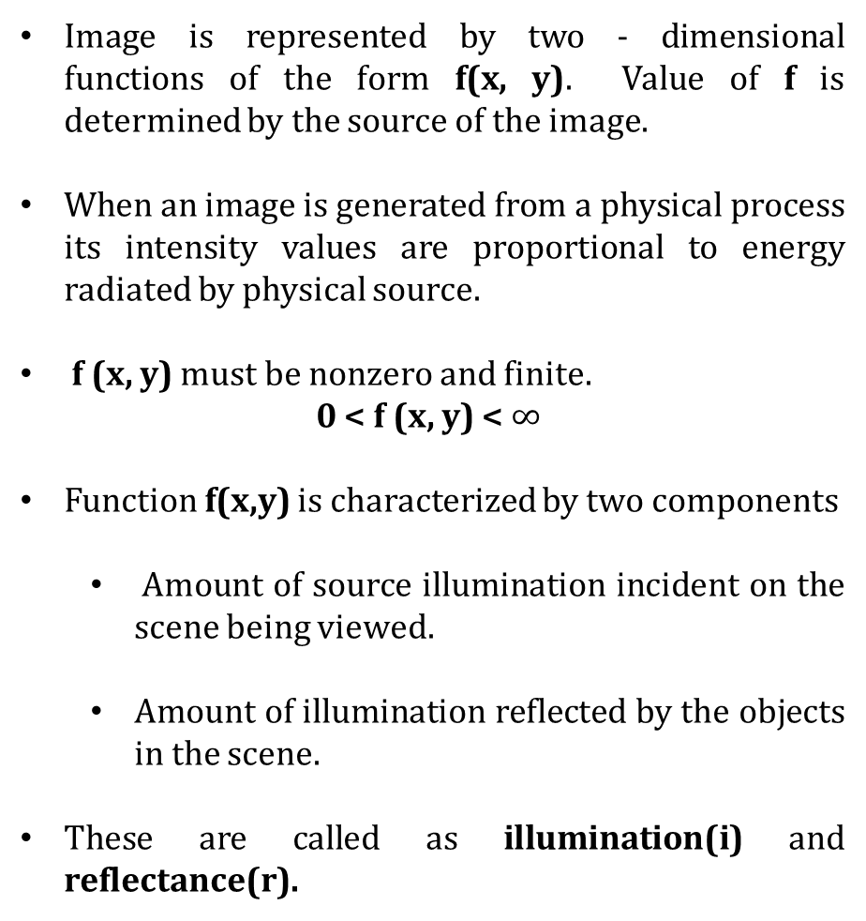
A Simple Image Formation Model
Image is represented by two - dimensional functions of the form f(x, y). Value of f is determined by the source of the image.
When an image is generated from a physical process its intensity values are proportional to energy radiated by physical source.
f (x, y) must be nonzero and finite.
0 < f (x, y) < $∞$
Function f(x,y) is characterized by two components
Amount of source illumination incident on the scene being viewed.
Amount of illumination reflected by the objects in the scene.
These are called as illumination(i) and reflectance(r).

Slide 22
A Simple Image Formation Model (Contd.)
Components represented by, i (x, y) and r (x, y)
Its product are, f (x, y) = i (x, y) r (x, y)
Where 0 <i (x, y) < ∞ and 0 < r (x, y) < 1
Reflectance is bounded by 0 (total absorption), 1 (total reflectance)
Nature of i (x, y) is determined by illumination source and r (x, y) is determined by characteristics of the imaged objects.

Slide 23
Takeaway from this session

Slide 24
MCQ
1. Which membrane of the eye covers the anterior surface and is tough and transparent?
a) Choroid
b) Retina
c) Sclera
d) Cornea
Answer: d) Cornea
2. The region of the retina with the highest density of cones and responsible for sharp, detailed vision is called:
a) Iris
b) Sclera
c) Fovea
d) Choroid
Answer: c) Fovea
3. The membrane that contains a network of blood vessels providing nutrition to the eye is called:
a) Cornea
b) Sclera
c) Choroid
d) Iris
Answer: c) Choroid
4. Which part of the eye controls the amount of light entering the eye through the pupil?
a) Choroid
b) Lens
c) Sclera
d) Iris
Answer: d) Iris
5. Which receptors in the retina are highly sensitive to color and concentrated in the central portion?
a) Rods
b) Cones
c) Ciliary body
d) Optic nerve
Answer: b) Cones
6. What is the phenomenon known as when objects appear colorless in dim light due to stimulation of rods only?
a) Scotopic vision
b) Photopic vision
c) Astigmatism
d) Myopia
Answer: a) Scotopic vision

Slide 25
Rods vs Cones (Responsible for us seeing brightness and color)
Cones
Rods
Contain photo-pigment
Respond to high energy
Enhance perception
Concentrated in fovea, exist sparsely in retina
Three types, sensitive to different wavelengths
Contain photo-pigment
Respond to low energy
Enhance sensitivity
Concentrated in retina, but outside of fovea
One type, sensitive to grayscale changes

Slide 26
Illumination and Reflectance
Brightness versus Lightness
Color constancy

Slide 27
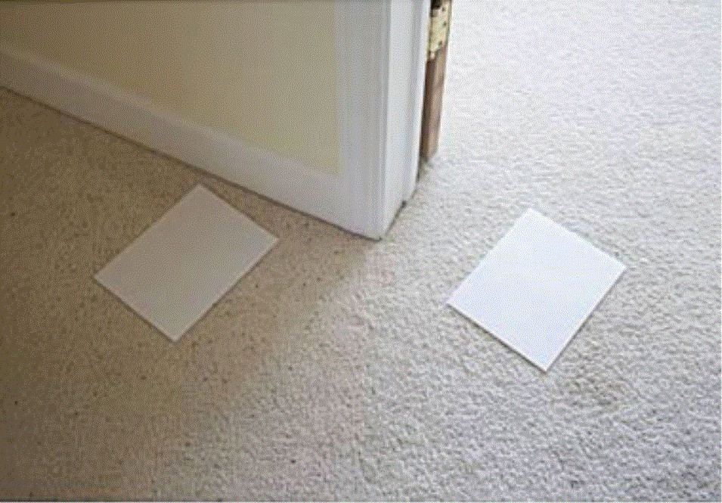
Which paper is lighter ?
Paper on the left is in shadow. It has lower physical intensity and it appears darker.
But do both papers seem to be of same (white) material?

Slide 28
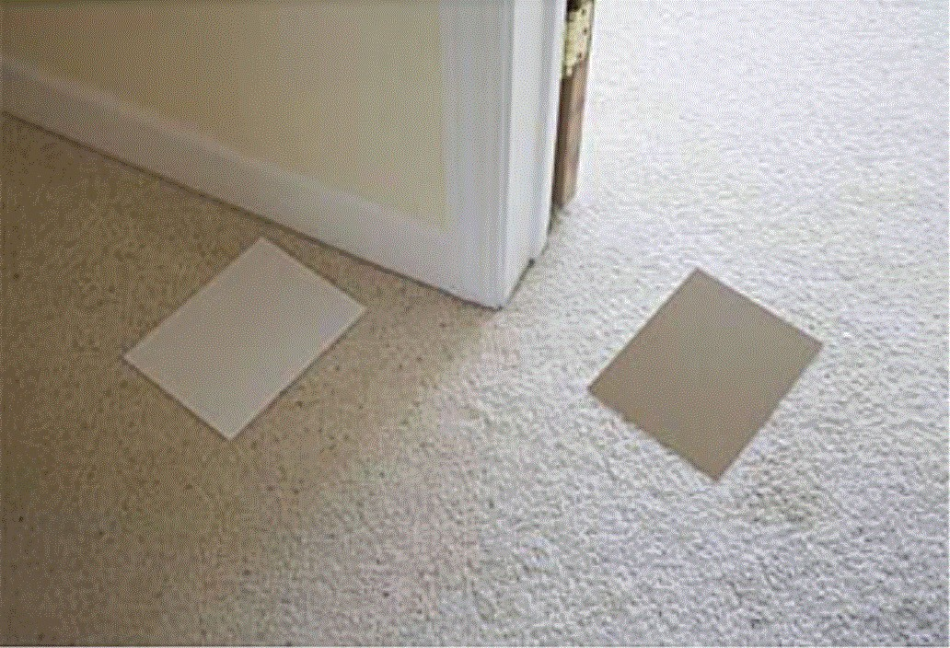
Which paper is lighter ?
Image is processed so that the right paper is given same image intensities as left paper.
Now, right paper appears to be made of different material. Why?

Slide 29

Physical quantities
luminance
“Real” example
𝐼 𝑥, 𝑦
= 𝑖𝑙𝑙𝑢𝑚𝑖𝑛𝑎𝑡𝑖𝑜𝑛 𝑥, 𝑦
∗ 𝑟𝑒𝑓𝑙𝑒𝑐𝑡𝑎𝑛𝑐𝑒 (𝑥, 𝑦)
shading & shadows
material
Abstract version

Slide 30
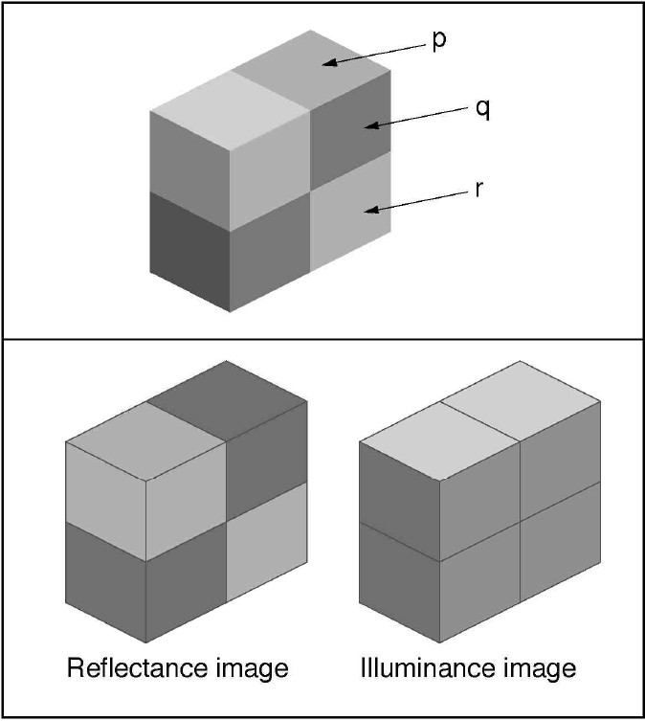
Physical quantities
low reflectance,
high illumination
low reflectance, low illumination
high reflectance, low illumination

Slide 31
Perceptual quantities
“brightness”
𝐼 𝑥, 𝑦
= 𝑖𝑙𝑙𝑢𝑚𝑖𝑛𝑎𝑡𝑖𝑜𝑛 𝑥, 𝑦
∗ 𝑟𝑒𝑓𝑙𝑒𝑐𝑡𝑎𝑛𝑐𝑒 (𝑥, 𝑦)
(no standard term for
perceived illumination)
“lightness”

Slide 32
“Lightness” perception
Q: What is the task ?
What problem is being solved?
A: Estimate the surface reflectance, by discounting the illumination.
𝐼 𝑥, 𝑦 = 𝑖𝑙𝑙𝑢𝑚𝑖𝑛𝑎𝑡𝑖𝑜𝑛 𝑥, 𝑦 ∗ 𝑟𝑒𝑓𝑙𝑒𝑐𝑡𝑎𝑛𝑐𝑒 (𝑥, 𝑦)
?

Slide 33
“Lightness” perception:
solution sketch
Q: What is the task ? What problem is being solved?
A: Estimate the surface reflectance, by discounting illumination effects.
Compare points that have same illumination.
𝐼 𝑥₁, 𝑦₁ 𝑖𝑙𝑙𝑢𝑚𝑖𝑛𝑎𝑡𝑖𝑜𝑛 ∗ 𝑟𝑒𝑓𝑙𝑒𝑐𝑡𝑎𝑛𝑐𝑒 (𝑥₁, 𝑦₁)
=
𝐼 𝑥₂, 𝑦₂ 𝑖𝑙𝑙𝑢𝑚𝑖𝑛𝑎𝑡𝑖𝑜𝑛 ∗ 𝑟𝑒𝑓𝑙𝑒𝑐𝑡𝑎𝑛𝑐𝑒 (𝑥₂, 𝑦₂)

Slide 34
Color constancy
Absorption
by photoreceptors
(fraction)
Illumination
Surface Reflectance (fraction)
There are three different spectra here.

Slide 35
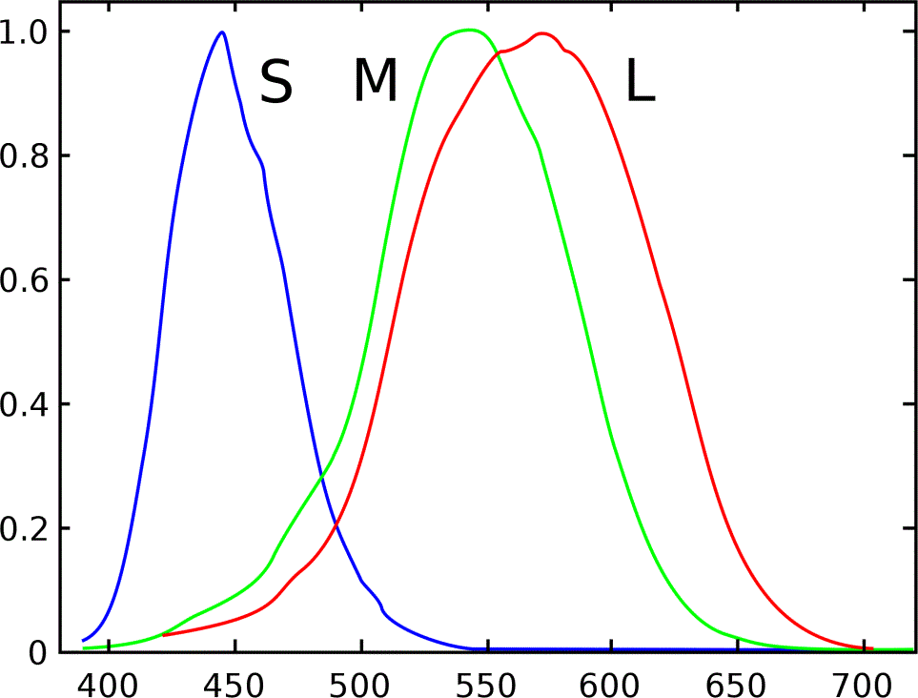
LMS cone responses
Types of Cones: The three types of cones are named based on their sensitivity to different colors of light:
L cones (long-wavelength) are most sensitive to red light.
M cones (medium-wavelength) are most sensitive to green light.
S cones (short-wavelength) are most sensitive to blue light.
Cone response
∫ 𝐼 𝑥, 𝑦, 𝜆 𝐶_{𝐿𝑀𝑆}(𝜆) 𝑑𝜆
𝐼 𝑥, 𝑦, 𝜆
= 𝑖𝑙𝑙𝑢𝑚𝑖𝑛𝑎𝑡𝑖𝑜𝑛 𝑥, 𝑦, 𝜆
∗ 𝑟𝑒𝑓𝑙𝑒𝑐𝑡𝑎𝑛𝑐𝑒 𝑥, 𝑦, 𝜆

Slide 36
Surface Color Perception
Q: What is the task? What is the problem to be solved?
A:
illumination
Surface Reflectance

Slide 37
Surface Color Perception
Q: What is the task? What is the problem to be solved?
A: Estimate the surface reflectance, by discounting the illumination.
illumination
Surface Reflectance
𝐼 𝑥, 𝑦, 𝜆
= 𝑖𝑙𝑙𝑢𝑚𝑖𝑛𝑎𝑡𝑖𝑜𝑛 𝑥, 𝑦, 𝜆
∗ 𝑟𝑒𝑓𝑙𝑒𝑐𝑡𝑎𝑛𝑐𝑒 𝑥, 𝑦, 𝜆
35

